Slide 1

Review Rating Prediction
Konatala Mohit
Intership-23 , ID-34

Slide 2

Abstract
Introduction
Descriptive Analysis
Data cleaning and modifying
Data Visualization
Feature Selection and Model Training
Conclusion

Slide 3

Abstract
Data analysis and model building on extracted data from flipkart website to predict the classification of the rating by using the full text review.

Slide 4

In this report I will be discussing about text classification of full review of an electronic product by using nltk library and few of the machine learning models via python and its libraries. On E-commerce platform reviews and rating are the important annotations which define the sales of a product also help the back-end sales executive and distributors to get handful feedback on the product which in return helps to improvise the product. This project to help a client who has a website where different set of audience write a review for the product. And to cut short the review into a review we need to a model which can rate the review in star rating scaling from 1 to 5. To rate a full review of a product, one must have a good understanding of natural language processing, and usage of natural language toolkit to make the required data abled to feed it to a machine learning model.

Slide 5

Exploratory Data Analysis
Objective:
Analysis of the data set and summarizing the factor that effect the classification of the label.
Understanding the Data Via Descriptive analysis
Size of the data is 28005 rows and 6 columns.
Rating is the target column

Slide 6
Data contains four Null Values in review column.
Data contains text in string format
Descriptive analysis is used as it gives the basic value Insite of the data in our dataset.
It helps in organize the data and summarize the data while describing the characteristic of data.

Slide 7
Data Visualization
Data visualization is one simplest way to get a proper idea about the characteristics of the data just from vision. In much simpler words , we Visualize the descriptive stats of the data in pictorial format. Also the data characteristic are represented in eye soothing way
Identifying pattern, understanding is the data is more easier through visuals.

Slide 8
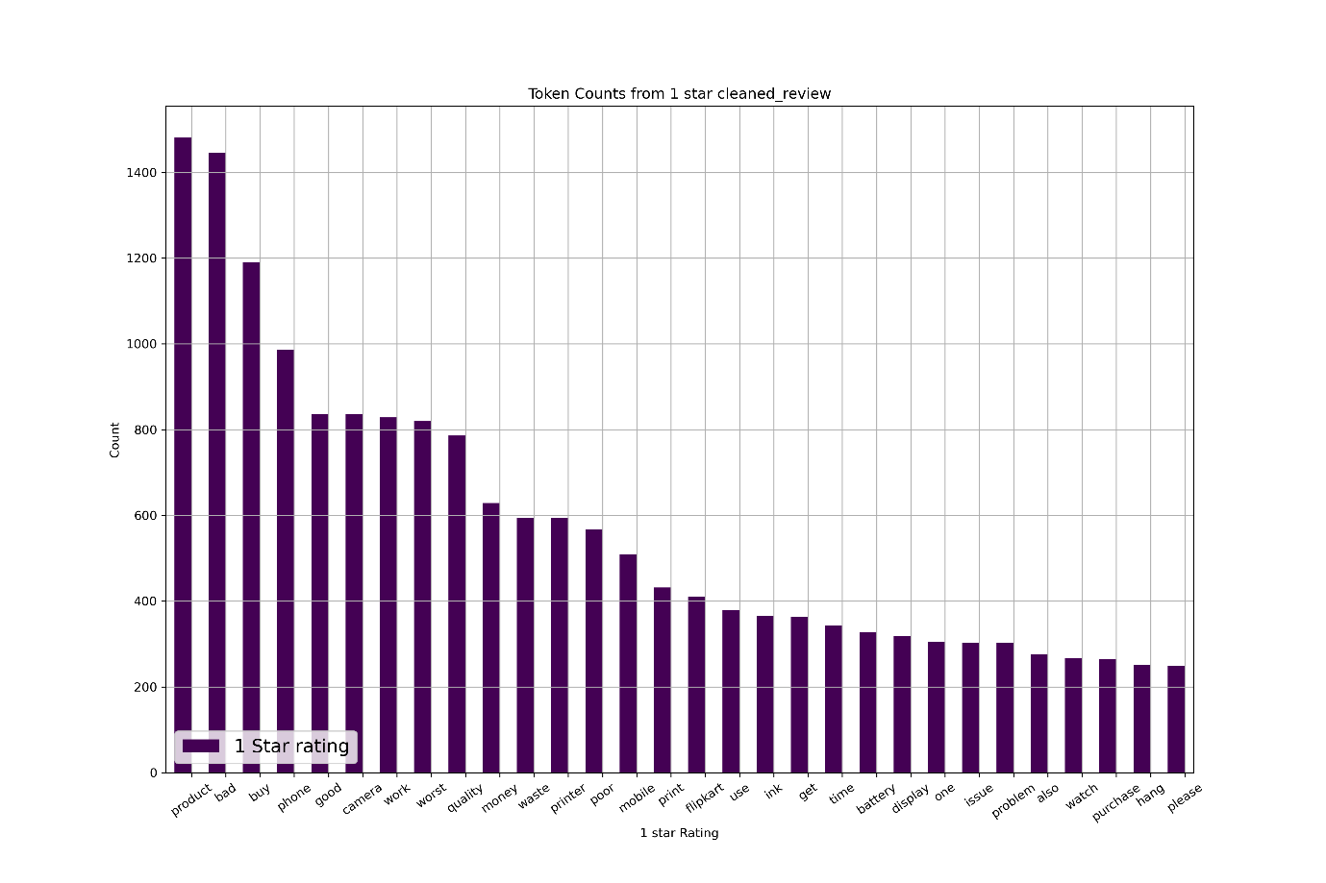
Independent variables influencing the target variable pie chart

Slide 9
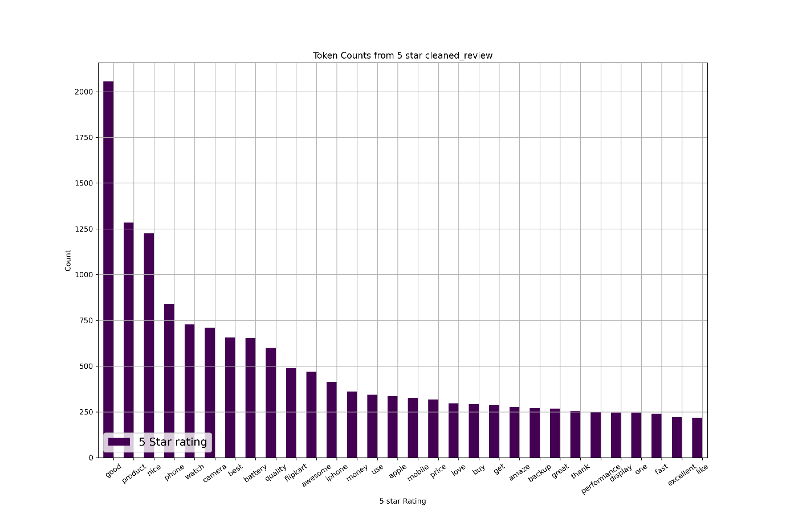
Independent variables influencing the target variable pie chart

Slide 10
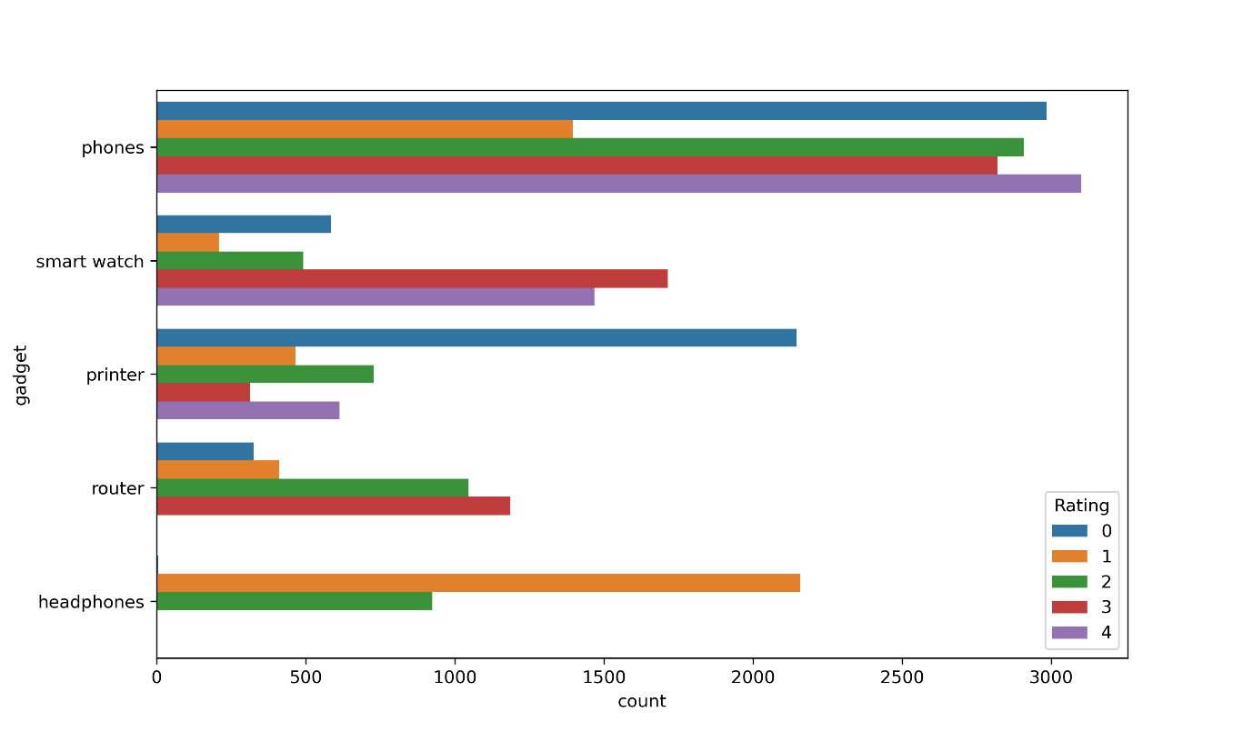
Bivariate Analysis

Slide 11
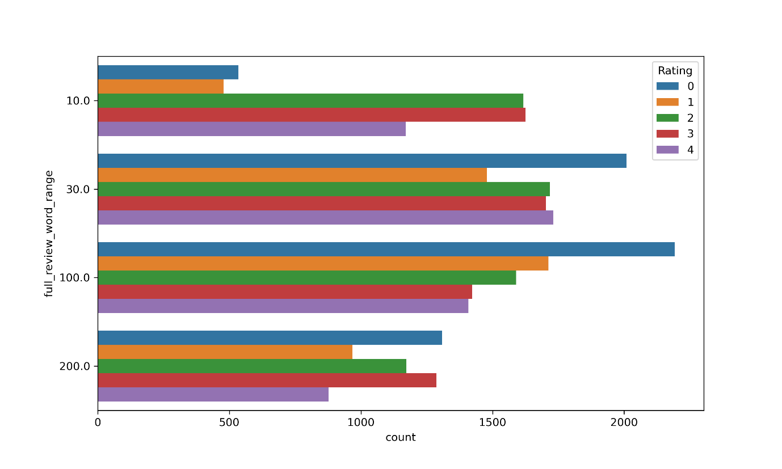
Bivariate Analysis

Slide 12
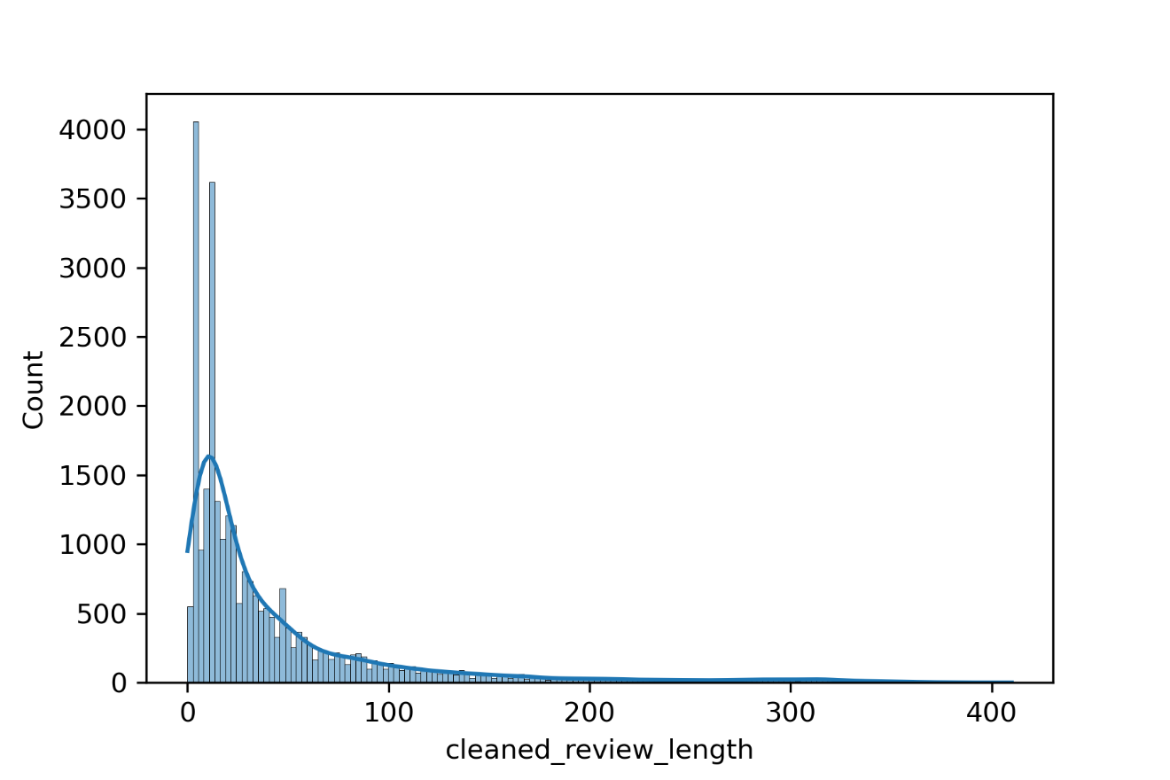
Univariate Analysis

Slide 13
Cleaning the Data
Cleaning data is one of the most important procedure in data analysis i.e. detecting and modifying or removing the inaccurate data from the dataset so as improve data quality
Tasks in data cleaning:
Word Tokenization
Removal of Punctuation and stop words
Lemmatization of the words
Feature Selection

Slide 14
Data Transforming:
label token frequency inverse document frequency vectorizer to transform and fit the ordinal data present in the data set into numerical form. Tfidfvectorizer not convert the data into numerical form but has the ability to normalize the data.
Pipeline of model and prediction:
After separating the train and test data we use Pipeline for model training and prediction as it makes the process simpler.

Slide 15

Below the keys point in Summarizing the data analysis of Review Rating Prediction data:
Dataset contains 4 null values.
Word length of Summary is minimum
The dataset is multi-class type. It contains 5 different class which indicate rating of the full review.
Only Rating column is in numerical form rest all columns are in text format.
Average length of uncleaned review is 68.6 words where as average length of cleaned review is 44.6 words.
Majority of the data scrapped is of phone electronic followed by watches and printers respectively. Router data is minor in the dataset.
Router has the minimum one-star rating where as phones have maximum five-star ratings. Printers have the least five -star rating.
Good and product are most used words in the review.
Good is almost common and top most used word in all the ratings.
Nice, quality, awesome, product some of the top words in 4 and 5-star rating.

Slide 16
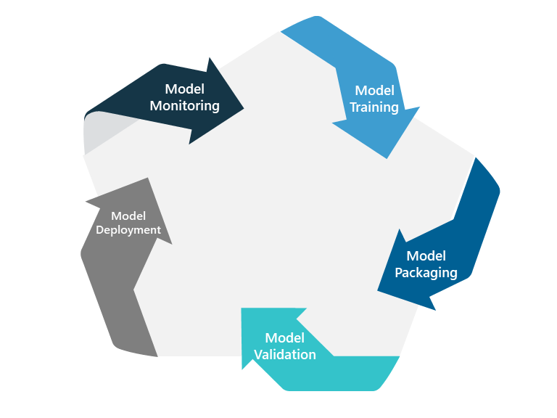
Model Training and Testing
Splitting the Data into Train and Test sets
Pipelining the model
Using hyperparameter tuning to get the best estimator for the model
Model Training
Cross Validation
Model Testing
Saving the model

Slide 17
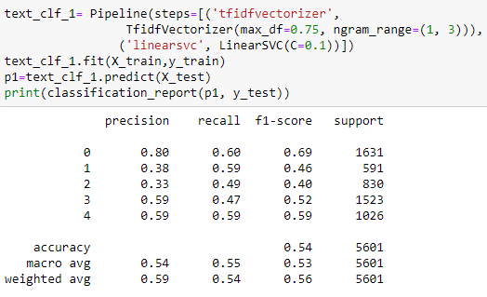

Slide 18
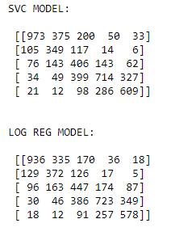
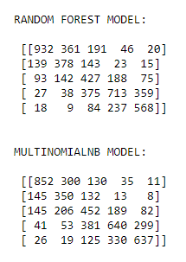
CONFUSION MATRIX

Slide 19

Limitations of this work and Scope for Future Work:
The label predicted are only limited to particular electronic gadgets. When we try to predict for other type electronic gadgets the machine learning model will fail. To improve the model efficiency, we can add more of type of gadgets and increase the size of the data in order to balance the data and get much improved precision, recall and f1-score for the given model. Also, by removing more unnecessary words from the data which are not affecting the output data the model can be improvised.
Conclusion:
Linear SVC machine learning model has performed better than all the other model as it has better accuracy and precision score for every label compared to other machine learning models. Also, True Positive and True Negative values for every label is in better balance for Linear SVC model.

